Slide 1

Power Supply Unit
Presented By:
Elizer Ponio Jr.

Slide 2
Power Supply Unit
What is a Power Supply Unit?
Efficiency Rating
Types of Power Supply Units
Power Rating
Precaution
Recommendations

Slide 3
What is a Power Supply Unit?
It supplies power to every component in a computer system.
It also converts alternating current (AC) to low voltage direct current (DC).
Power supply unit prices varies depending on the quality of the components inside (capacitors and power delivery systems).

Slide 4
How do you know if it is a good power supply?

Slide 5

80 Plus Rating
Power supply units are rated based on their efficiency rating.
Any power supply that is 80 percent efficient at delivering power is considered a “good power supply”.
Efficiency refers to the power it draws from the wall and the
energy wasted.
The higher the efficiency, the lower energy will be wasted.

Slide 6
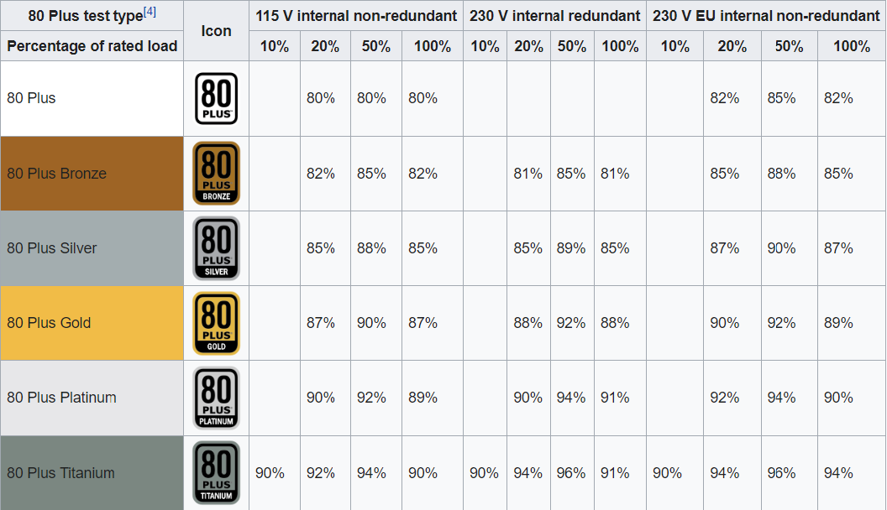
80 Plus Rating

Slide 7
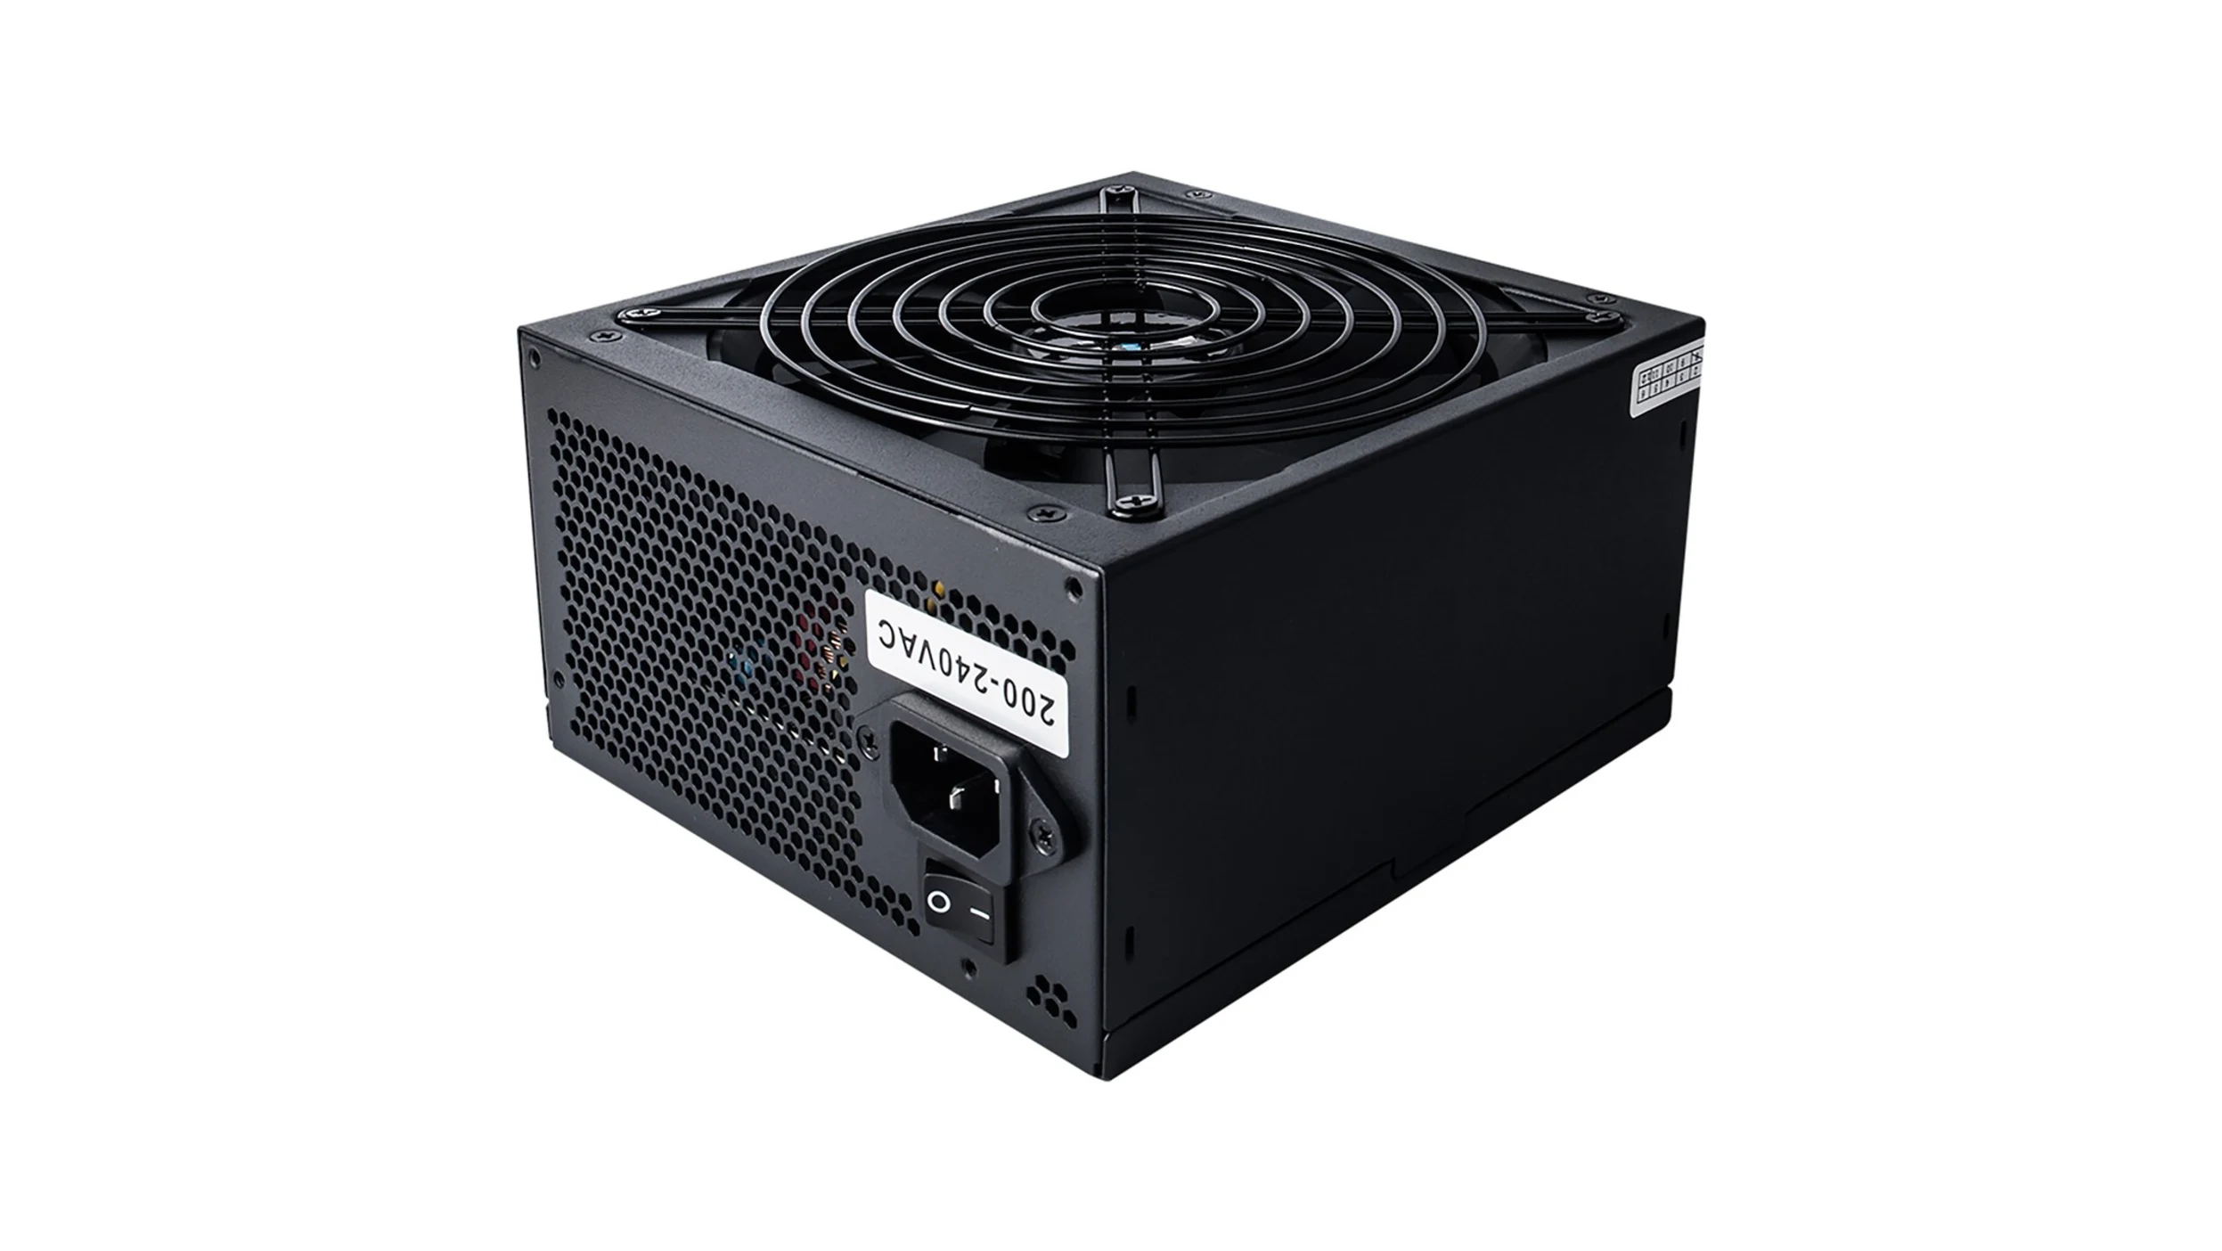
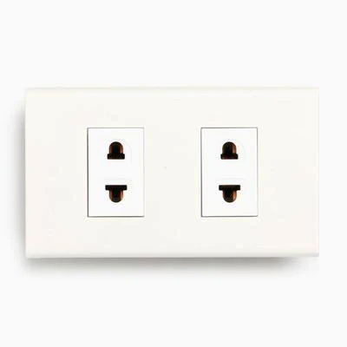
80 Plus Rating
Power Wasted: 750 – 600 = 150 watts
150 watts wasted as heat
750 watts pulled from the wall
Power Draw: 600 / (80/100) = 750 watts
At 100% percent load
Power Rating: 600 watts
Efficiency Rating: 80 Plus White

Slide 8
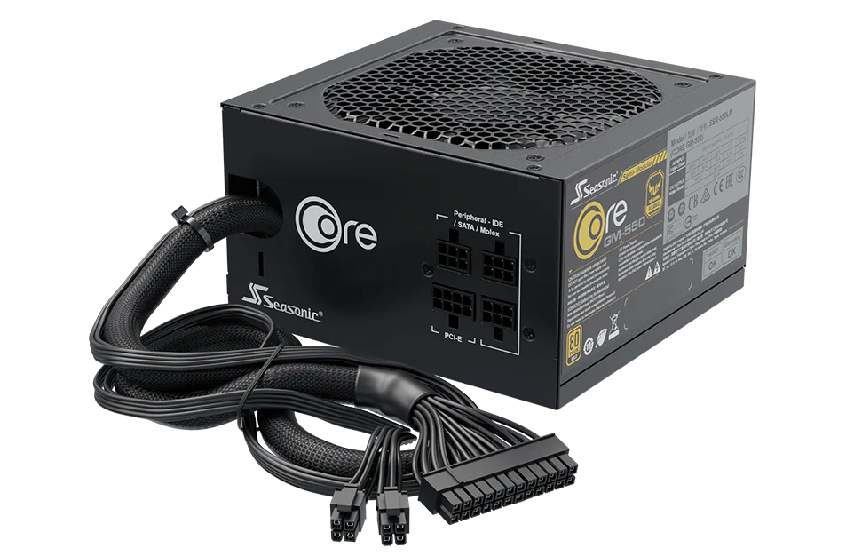
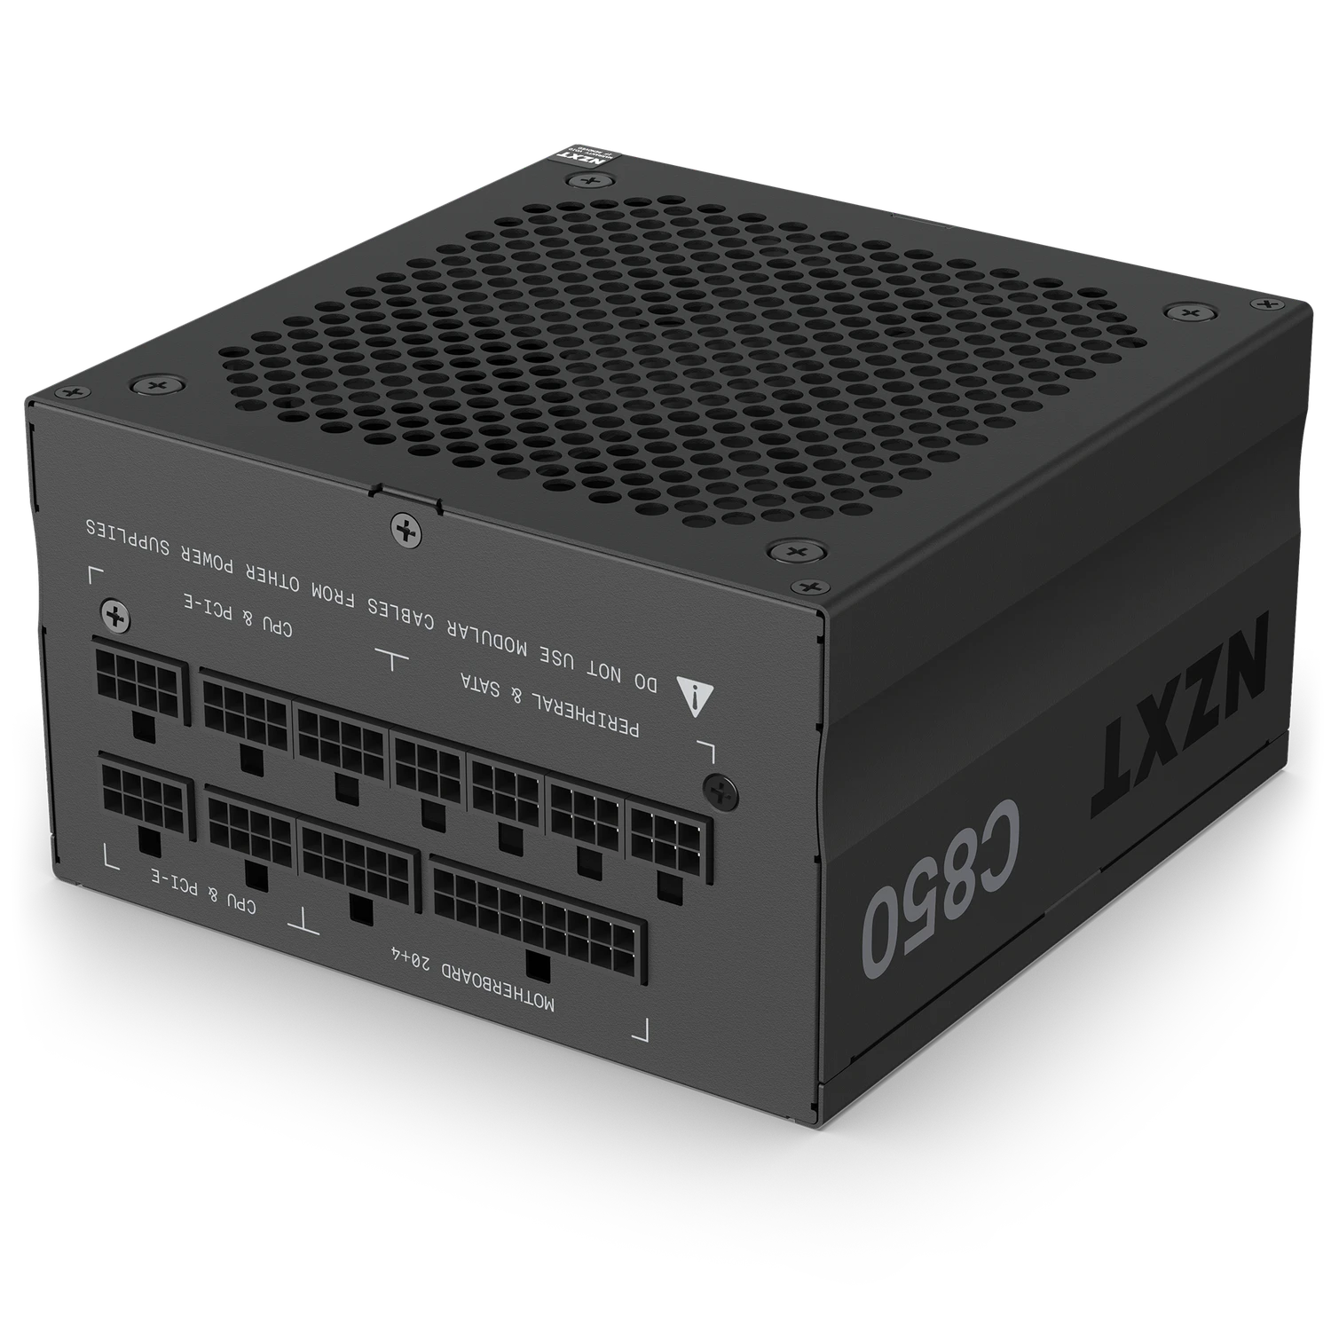
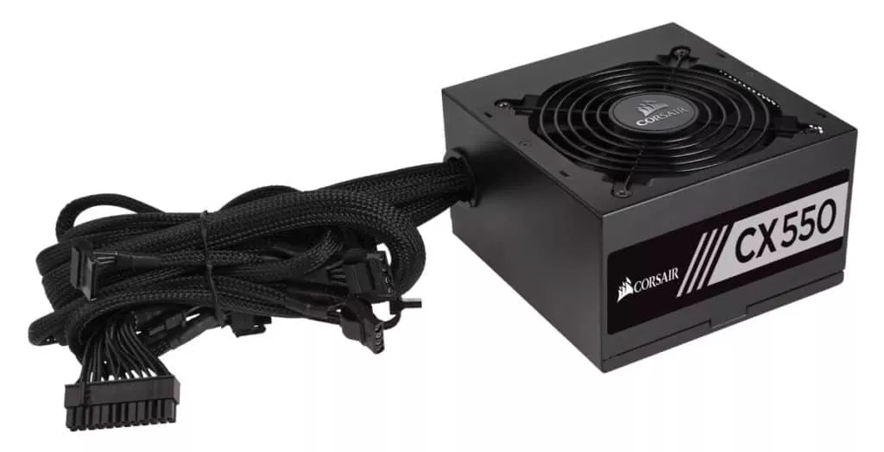
Types of Power Supply Units
Non-modular
Semi-modular
Modular

Slide 9
Power Rating
The power rating indicates the maximum power in watts the PSU can provide to a computer system.
If a computer system needs 500 watts, the power supply needed for that system should have a power rating greater than 500 watts.
Having a power supply rated at 1000 watts does not mean that it will always pull 1000 watts from the wall. It only provides the power that computer system is actually pulling.

Slide 10
Precaution
In an event where the computer system pulls power that is greater that the PSU can provide, the PSU will automatically shut down in order to prevent component damage.

Slide 11
Recommendations
It is recommended to buy a power supply with at least a power rating of 850 watts.
Having an overhead or extra wattage that your computer system actually needs will give you extra room whenever you decide to add components that require additional power.
Buy a power supply with an efficiency rating of 80 plus gold.

